Slide 1
Searching and Sorting Algorithms
Binary Search, Selection, Bubble Sort, Insertion, QuickSort and MergerSort
SoftUni Team
Technical Trainers
Software University
https://about.softuni.bg

Slide 2
Table of Contents
Searching Algorithms
Linear Search
Binary Search
Simple Sorting Algorithms
Selection, Bubble Sort and Insertion
Advanced Sorting Algorithms
QuickSort, MergeSort
2
Notes:
2

Slide 3


Searching Algorithms
Linear and Binary Search

Slide 4
Search Algorithm
Search algorithm == an algorithm for finding an item with specified properties among a collection of items
Different types of searching algorithms:
For sub-structures of a given structure
A graph, a string, a finite group
Search for the min / max of a function, etc.

Slide 5
Linear Search
Linear search finds a particular value in a list
Checking every one of the elements
One at a time, in sequence
Until the desired one is found
Worst & average performance: O(n)
for each item in the list:
if that item has the desired value,
return the item's location
return nothing

Slide 6
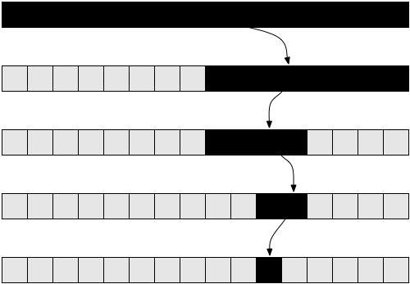
Binary Search
Binary search finds an item within an ordered data structure
At each step, compare the input with the middle element
The algorithm repeats its action to the left or right sub-structure
Average performance: O(log(n))
See the visualization

Slide 7
Binary Search (Iterative)
def binary_search(numbers, target):
left = 0
right = len(numbers) - 1
while left <= right:
mid_idx = (left + right) // 2
mid_el = numbers[mid_idx]
if mid_el == target:
return mid_idx
if mid_el < target:
left = mid_idx + 1
else:
right = mid_idx - 1
return -1

Slide 8

Simple Sorting Algorithms
Selection, Bubble and Insertion Sort

Slide 9
What is a Sorting Algorithm?
Sorting algorithm
An algorithm that rearranges elements in a list
In non-decreasing order
Elements must be comparable
More formally
The input is a sequence / list of elements
The output is a rearrangement / permutation of elements
In non-decreasing order

Slide 10

Sorting – Example
Efficient sorting algorithms are important for:
Producing human-readable output
Canonicalizing data – making data uniquely arranged
In conjunction with other algorithms, like binary searching
Example of sorting:
Unsorted list
sorting
Sorted list
10 | 3 | 7 | 3 | 4
3 | 3 | 4 | 7 | 10

Slide 11
Sorting Algorithms: Classification
Sorting algorithms are often classified by:
Computational complexity and memory usage
Worst, average and best-case behavior
Recursive / non-recursive
Stability – stable / unstable
Comparison-based sort / non-comparison based

Slide 12
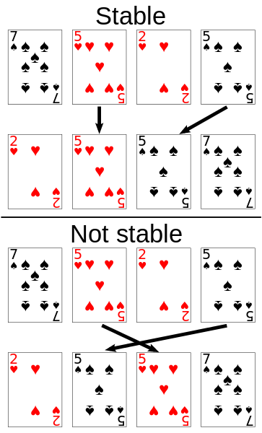
Stability of Sorting
Stable sorting algorithms
Maintain the order of equal elements
If two items compare as equal, their relative order is preserved
Unstable sorting algorithms
Rearrange the equal elements in unpredictable order
Often different elements have same key used for equality comparing

Slide 13
Selection Sort
Selection sort – simple, but inefficient algorithm
Swap the first with the min element on the right, then the second, etc.
Memory: O(1)
Time: O(n²)
Stable: No
Method: Selection

Slide 14
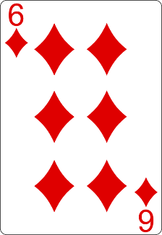
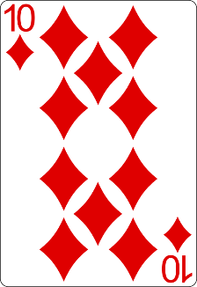
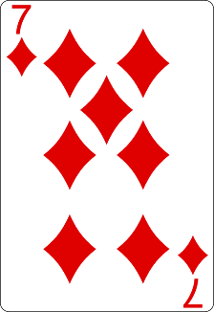
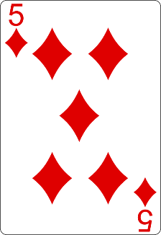
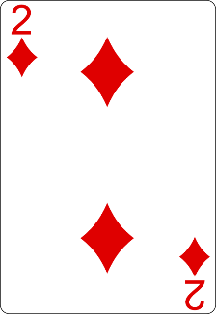
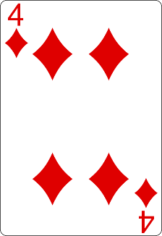
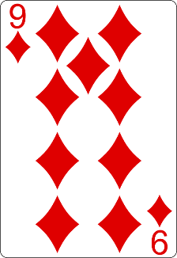
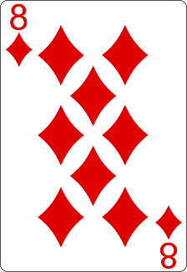
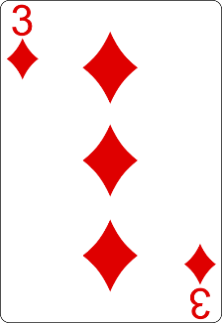
Selection Sort Visualization
Index
Min

Slide 15
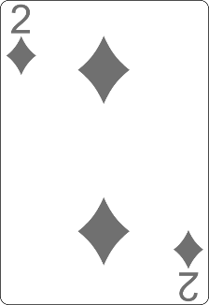
Selection Sort Visualization
Index
Min

Slide 16
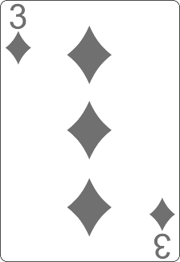
Selection Sort Visualization
Index
Min

Slide 17
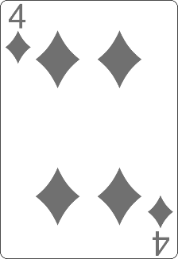
Selection Sort Visualization
Min
Index

Slide 18
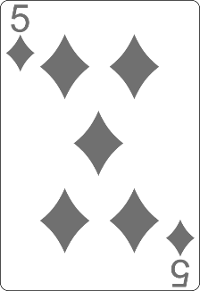
Selection Sort Visualization
Min
Index

Slide 19
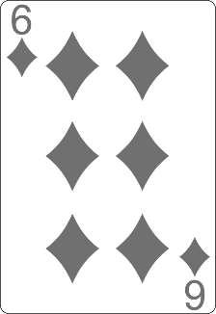
Selection Sort Visualization
Min
Index

Slide 20
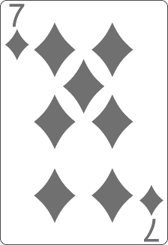
Selection Sort Visualization
Index
Min

Slide 21
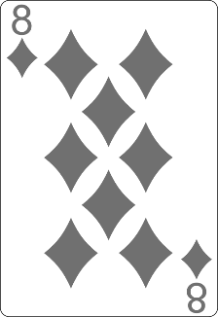
Selection Sort Visualization
Min
Index

Slide 22
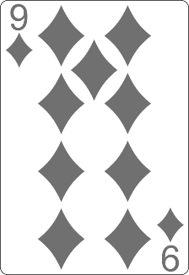
Selection Sort Visualization
Min
Index

Slide 23
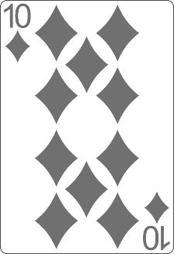
Selection Sort Visualization

Slide 24
Selection Sort Visualization

Slide 25
Selection Sort Code
for idx in range(len(nums)):
min_idx = idx
for curr_idx in range(idx + 1, len(nums)):
if nums[curr_idx] < nums[min_idx]:
min_idx = curr_idx
nums[idx], nums[min_idx] = nums[min_idx], nums[idx]

Slide 26
Bubble Sort
Bubble sort – simple, but inefficient algorithm
Swaps to neighbor elements when not in order until sorted
Memory: O(1)
Time: O(n²)
Stable: Yes
Method: Exchanging

Slide 27
Bubble Sort Visualization
i
j

Slide 28
Bubble Sort Visualization
i
j

Slide 29
Bubble Sort Visualization
i
j

Slide 30
Bubble Sort Visualization
i
j

Slide 31
Bubble Sort Visualization
i
j

Slide 32
Bubble Sort Visualization
i
j

Slide 33
Bubble Sort Visualization
i
j

Slide 34
Bubble Sort Visualization
i
j

Slide 35
Bubble Sort Visualization
i
j

Slide 36
Bubble Sort Visualization
i
j

Slide 37
Bubble Sort Visualization
i
j

Slide 38
Bubble Sort Visualization
i
j

Slide 39
Bubble Sort Visualization
i
j

Slide 40
Bubble Sort Visualization
i
j

Slide 41
Bubble Sort Visualization
i
j

Slide 42
Bubble Sort Visualization
i
j

Slide 43
BubbleSort
nums = [1, 3, 4, 2, 5, 6]
for i in range(len(nums)):
for j in range(1, len(nums) - i):
if nums[j - 1] > nums[j]:
nums[j], nums[j - 1] = nums[j - 1], nums[j]

Slide 44
Bubble Sort (2)
nums = [1, 3, 4, 2, 5, 6]
is_sorted = False
i = 0
while not is_sorted:
is_sorted = True
for j in range(1, len(nums) - i):
if nums[j - 1] > nums[j]:
nums[j], nums[j - 1] = nums[j - 1], nums[j]
is_sorted = False
i += 1

Slide 45
Comparison of Sorting Algorithms
Name | Best | Average | Worst | Memory | Stable | Method
Selection | n² | n² | n² | 1 | No | Selection
Bubble | n | n² | n² | 1 | Yes | Exchanging

Slide 46
Insertion Sort
Insertion Sort – simple, but inefficient algorithm
Move the first unsorted element left to its place
Memory: O(1)
Time: O(n²)
Stable: Yes
Method: Insertion

Slide 47
Insertion Sort Visualization
i
j

Slide 48
Insertion Sort Visualization
i
j

Slide 49
Insertion Sort Visualization
i
j

Slide 50
Insertion Sort Visualization
i
j

Slide 51
Insertion Sort Visualization
i
j

Slide 52
Insertion Sort Visualization
i
j

Slide 53
Insertion Sort Visualization
i
j

Slide 54
Insertion Sort Visualization
i
j

Slide 55
Insertion Sort Visualization
i
j

Slide 56
Insertion Sort Visualization
i
j

Slide 57
Insertion Sort Visualization
i
j

Slide 58
Insertion Sort Visualization
i
j

Slide 59
Insertion Sort
for i in range(len(nums)):
j = i
while j > 0 and nums[j] < nums[j - 1]:
nums[j], nums[j - 1] = nums[j - 1], nums[j]
j -= 1

Slide 60
Comparison of Sorting Algorithms
Name | Best | Average | Worst | Memory | Stable | Method
Selection | n² | n² | n² | 1 | No | Selection
Bubble | n | n² | n² | 1 | Yes | Exchanging
Insertion | n | n² | n² | 1 | Yes | Insertion

Slide 61

Advanced Sorting Algorithms
QuickSort, MergeSort

Slide 62
Quick Sort
QuickSort – efficient sorting algorithm
Choose a pivot; move smaller elements left & larger right; sort left & right
Memory: O(log(n)) stack space (recursion)
Time: O(n²)
When the pivot element divides the array into two unbalanced sub-arrays (huge difference in size)
Stable: Depends
Method: Partitioning

Slide 63
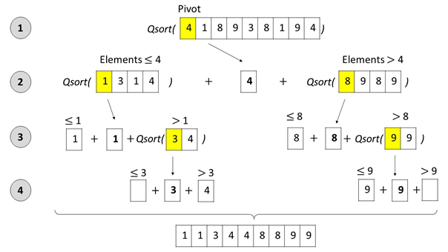
Quick Sort: Conceptual Overview

Slide 64
Quick Sort
def quick_sort(nums, start, end):
if start >= end:
return
pivot, left, right = start, start + 1, end
while left <= right:
if nums[left] > nums[pivot] > nums[right]:
nums[left], nums[right] = nums[right], nums[left]
if nums[left] <= nums[pivot]:
left += 1
if nums[right] >= nums[pivot]:
right -= 1
nums[pivot], nums[right] = nums[right], nums[pivot]
quick_sort(nums, start, right - 1)
quick_sort(nums, right + 1, end)

Slide 65
Comparison of Sorting Algorithms
Name | Best | Average | Worst | Memory | Stable | Method
Selection | n² | n² | n² | 1 | No | Selection
Bubble | n | n² | n² | 1 | Yes | Exchanging
Insertion | n | n² | n² | 1 | Yes | Insertion
Quick | n * log(n) | n * log(n) | n² | n * log(n) | Depends | Partitioning

Slide 66
Merge Sort
Merge sort is efficient sorting algorithm
Divide the list into sub-lists (typically 2 sub-lists)
Sort each sub-list (recursively call merge-sort)
Merge the sorted sub-lists into a single list
Memory: O(n) / O(n*log(n))
Time: O(n*log(n))
Highly parallelizable on multiple cores / machines → up to O(log(n))

Slide 67
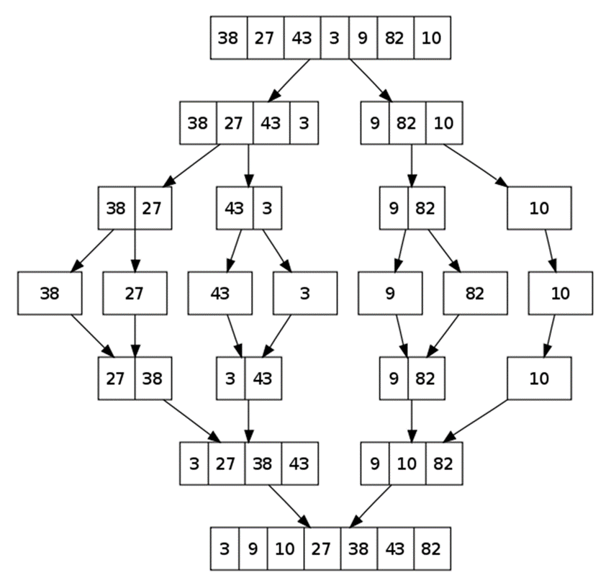
Merge Sort: Conceptual Overview

Slide 68
Merge Sort (1)
# Memory: O(n*log(n))
def merge_sort(nums):
if len(nums) == 1:
return nums
mid_idx = len(nums) // 2
left = nums[:mid_idx]
right = nums[mid_idx:]
return merge_arrays(merge_sort(left), merge_sort(right))

Slide 69
Merge Sort (2)
def merge_arrays(left, right):
sorted_arr = []
left_idx, right_idx = 0, 0
while left_idx < len(left) and right_idx < len(right):
if left[left_idx] < right[right_idx]:
sorted_arr.append(left[left_idx])
left_idx += 1
else:
sorted_arr.append(right[right_idx])
right_idx += 1
# TODO: Take remaining elements either from the left or right
return sorted_arr

Slide 70
Merge Sort (3)
while left_idx < len(left):
sorted_arr.append(left[left_idx])
left_idx += 1
while right_idx < len(right):
sorted_arr.append(right[right_idx])
right_idx += 1

Slide 71
Comparison of Sorting Algorithms
Name | Best | Average | Worst | Memory | Stable | Method
Selection | n² | n² | n² | 1 | No | Selection
Bubble | n | n² | n² | 1 | Yes | Exchanging
Insertion | n | n² | n² | 1 | Yes | Insertion
Quick | n * log(n) | n * log(n) | n² | n * log(n) | Depends | Partitioning
Merge | n * log(n) | n * log(n) | n * log(n) | n | Yes | Merging

Slide 72

Summary
Searching algorithms
Binary Search, Linear Search
Slow sorting algorithms:
Selection sort, Bubble sort, Insertion sort
Fast sorting algorithms:
Quick sort, Merge sort, etc.
How to choose the most appropriate algorithm?
Notes:
72

Slide 73
Questions?
Notes:
73

Slide 74












SoftUni Diamond Partners

Slide 75


Educational Partners

Slide 76

License
This course (slides, examples, demos, exercises, homework, documents, videos and other assets) is copyrighted content
Unauthorized copy, reproduction or use is illegal
© SoftUni – https://about.softuni.bg/
© Software University – https://softuni.bg
Notes:
76

Slide 77
Trainings @ Software University (SoftUni)
Software University – High-Quality Education, Profession and Job for Software Developers
softuni.bg, about.softuni.bg
Software University Foundation
softuni.foundation
Software University @ Facebook
facebook.com/SoftwareUniversity
Software University Forums
forum.softuni.bg
Notes:
77

